Slide 1
Objects and Classes

Slide 2
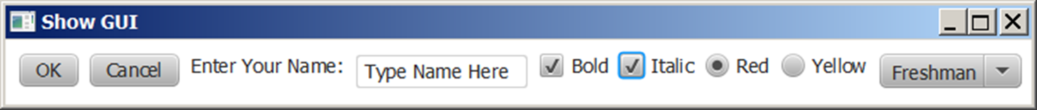
Motivations
After learning the preceding chapters, you are capable of solving many programming problems using selections, loops, methods, and arrays. However, these Java features are not sufficient for developing graphical user interfaces and large scale software systems. Suppose you want to develop a graphical user interface as shown below. How do you program it?

Slide 3
Introduction to Objects
As the number of variables and methods increases, it becomes increasingly challenging to manage them. An appealing idea is to group them according to which object they are refering to.

Slide 4
Introduction to Classes
As many objects share the similar group of variables and methods, they are abstracted as a class.
For example, a restaurant defines a data type that has a name, a rating, a menu, etc.

Slide 5
Classes and objects
class: A program entity that represents either:
1. A program / module, or
2. A template for a new type of objects.
object: An entity that combines state and behavior.
object-oriented programming (OOP): Programs that perform their behavior as interactions between objects.

Slide 6
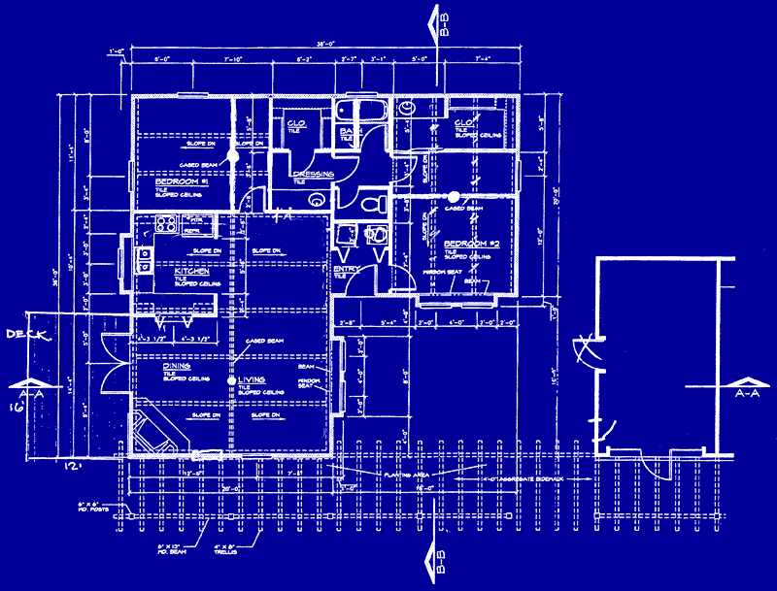
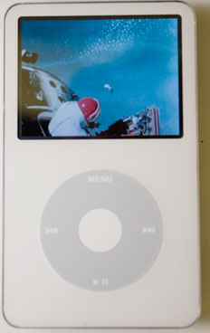
Blueprint analogy
iPod blueprint
state: current song volume battery life
behavior: power on/off change station/song change volume choose random song
creates
iPod #1
state: song = "1,000,000 Miles" volume = 17 battery life = 2.5 hrs
behavior: power on/off change station/song change volume choose random song
iPod #2
state: song = "Letting You" volume = 9 battery life = 3.41 hrs
behavior: power on/off change station/song change volume choose random song
iPod #3
state: song = "Discipline" volume = 24 battery life = 1.8 hrs
behavior: power on/off change station/song change volume choose random song

Slide 7
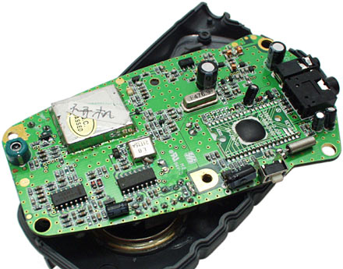
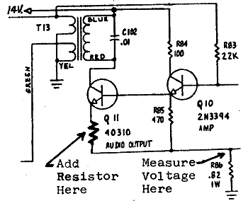
Abstraction
abstraction: A distancing between ideas and details.
We can use objects without knowing how they work.
abstraction in an iPod:
You understand its external behavior (buttons, screen).
You don't understand its inner details, and you don't need to.

Slide 8
Class members
Fields are variables associated to the class. They can be used by any method defined in the class.
methods are designed to perform certain action for the object.
Example: In the Book class, add a method named onSale() that cut the price off by 20%. Add method offSale() that restores the price.

Slide 9
Fields
field: A variable inside an object that is part of its state.
Each object has its own copy of each field.
Declaration syntax:
type name;
Example:
public class Student {
String name; // each Student object has a
double gpa; // name and gpa field
}

Slide 10
O O Programming Concepts
Object-oriented programming (O O P) involves programming using objects.
An object represents an entity in the real world that can be distinctly identified. For example, a student, a desk, a circle, a button, and even a loan can all be viewed as objects. An object has a unique identity, state, and behaviors.
The state of an object consists of a set of data fields (also known as properties) with their current values.
The behavior of an object is defined by a set of methods.

Slide 11
Objects
An object has both a state and behavior. The state defines the object, and the behavior defines what the object does.
Notes:
Class name, Circle.
Data fields. Radius is, blank space. Methods, getArea.
Three objects of the Circle class are as follows.
Circle object 1. Data fields, radius is 10.
Circle object 2. Data fields, radius is 25.
Circle object 3. Data fields, radius is 125.

Slide 12
Classes (1 of 2)
Classes are constructs that define objects of the same type.
A Java class uses variables to define data fields and methods to define behaviors.
Additionally, a class provides a special type of methods, known as constructors, which are invoked to construct objects from the class.

Slide 13
Classes (2 of 2)
Notes:
Line 1, indicates class Circle open braces. Line 2, slash forward address address The radius of this circle address slash forward. Line 3, double radius equal to 1.0 semicolon. The line 3 is Data field. Line 4, Blank. Line 5, slash forward address address Construct a circle object address slash forward. Line 6, Circle open parenthesis close parenthesis open braces. Line 7, close braces. Line 8, Blank. Line 9, slash forward address address Construct a circle object address slash forward. Line 10, Circle open parenthesis double new Radius close parenthesis open braces. Line 11, radius equal to new Radius semicolon. Line 12, close braces. The lines 5, 6, 7, 8, 9, 10, 11 and 12 are Constructors. Line 13, Blank. Line 14, slash forward address address Return the area of this circle address slash forward. Line 15, double get Area open parenthesis close parenthesis open braces. The line 15 is Method. Line 16, return radius address radius address 3 period 14159 semicolon. Line 17, close braces. Line 18, close braces.

Slide 14
U M L Class Diagram
Notes:
Row 1 shows the Class name (circle). Row 2 shows the Data fields (radius: double). Row 3 shows the computer coding of 6 lines for Constructors and methods. Line 1, indicates Circle open parenthesis close parenthesis. Line 2, Circle open parenthesis new Radius colon double close parenthesis. Line 3, g e t Area open parenthesis close parenthesis colon double. Line 4, g e t Perimeter open parenthesis close parenthesis colon double. Line 5, s e t Radius open parenthesis new Radius colon. Line 6, double close parenthesis colon void. A left side text box shows the 2 rows of UML notation for objects. Row 1 shows the Circle 1 colon Circle. Row 2 shows the radius equal to 1.0. A middle text box shows the 2 rows of UML notation for objects. Row 1 shows the Circle 2 colon Circle. Row 2 shows the radius equal to 25. A right side text box shows the 2 rows of UML notation for objects. Row 1 shows the Circle 3 colon Circle. Row 2 shows the radius equal to 125.

Slide 15
Example: Defining Classes and Creating Objects (1 of 2)
Objective: Demonstrate creating objects, accessing data, and using methods.
TestSimpleCircle: https://liveexample.pearsoncmg.com/html/TestSimpleCircle.html
TestSimpleCircle
Notes:
TestSimpleCircle: https://liveexample.pearsoncmg.com/html/TestSimpleCircle.html

Slide 16
Constructors (1 of 2)
Circle() {
}
Circle(double newRadius) {
radius = newRadius;
}
Constructors are a special kind of methods that are invoked to construct objects.

Slide 17
Constructors (2 of 2)
A constructor with no parameters is referred to as a no-arg constructor.
Constructors must have the same name as the class itself.
Constructors do not have a return type—not even void.
Constructors are invoked using the new operator when an object is created. Constructors play the role of initializing objects.

Slide 18
Creating Objects Using Constructors
new ClassName();
Example:
new Circle();
new Circle(5.0);

Slide 19
Default Constructor
A class may be defined without constructors. In this case, a no-arg constructor with an empty body is implicitly defined in the class. This constructor, called a default constructor, is provided automatically only if no constructors are explicitly defined in the class.

Slide 20
Declaring Object Reference Variables
To reference an object, assign the object to a reference variable.
To declare a reference variable, use the syntax:
ClassName objectRefVar;
Example:
Circle myCircle;

Slide 21
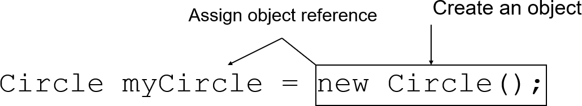
Declaring/Creating Objects in a Single Step
ClassName objectRefVar = new ClassName();
Example:
Notes:
An arrow from right side to the left side of = is labeled, assign object reference. The object new circle left parenthesis right parenthesis semi colon is labeled, create an object.

Slide 22
Accessing Object’s Members
Referencing the object’s data:
objectRefVar.data
e.g., myCircle.radius
Invoking the object’s method:
objectRefVar.methodName(arguments)
e.g., myCircle.getArea()

Slide 23
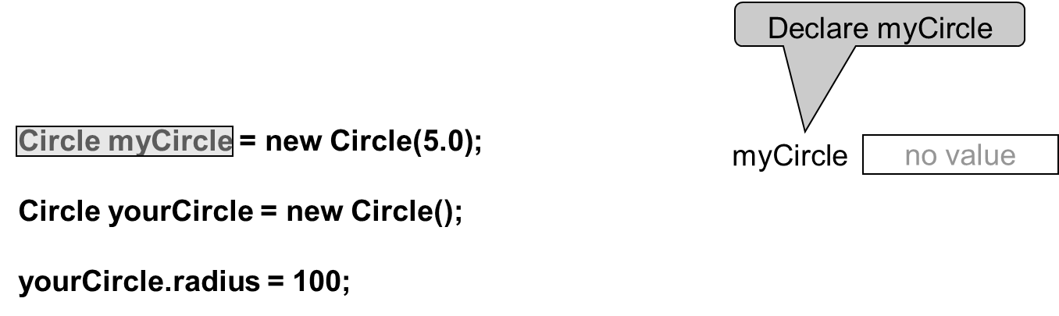
Trace Code (1 of 7)
Notes:
Line 1, indicates Circle my Circle equal to new Circle open parenthesis 5.0 close parenthesis semicolon. Line 2, blank. Line 3, Circle my Circle equal to new Circle open parenthesis close parenthesis semicolon.ine 4, blank. Line 5, your Circle period radius equal to hundred semicolon. A right side text box shows the 1 Row for Declare my Circle i.e. no value.

Slide 24
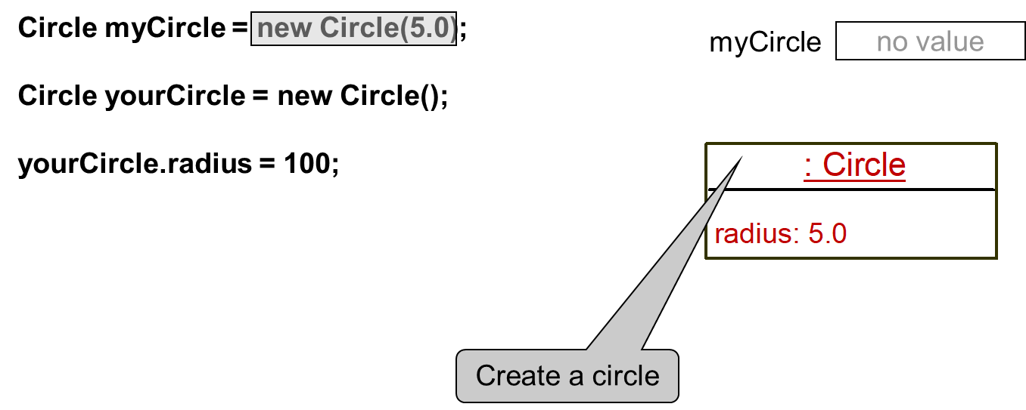
Trace Code (2 of 7)
Notes:
The computer code consists 5 lines. Line 1, indicates Circle my Circle equal to new Circle open parenthesis 5.0 close parenthesis semicolon. Line 2, blank. Line 3, Circle my Circle equal to new Circle open parenthesis close parenthesis semicolon. Line 4, blank. Line 5, your Circle period radius equal to hundred semicolon.
A right upward side text box shows 1 Row for my Circle i.e. no value. A right downward side text box shows the 2 rows. Row 1 shows the Create a circle by coding i.e. colon Circle. Row 2 shows the radius colon 5.0.

Slide 25
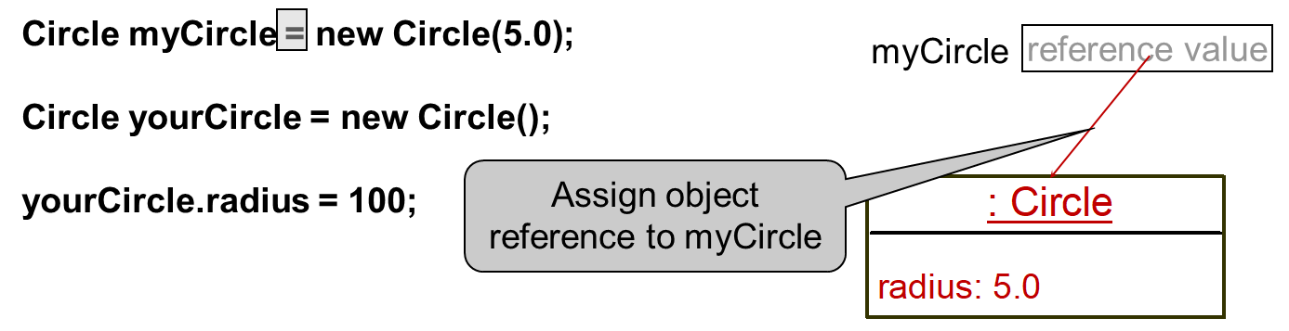
Trace Code (3 of 7)
Notes:
The computer code consists 5 lines. Line 1, indicates Circle my Circle equal to new Circle open parenthesis 5.0 close parenthesis semicolon. Line 2, blank. Line 3, Circle my Circle equal to new Circle open parenthesis close parenthesis semicolon. Line 4, blank. Line 5, your Circle period radius equal to hundred semicolon.
A right upward side text box shows 1 Row for my Circle i.e. reference value and it also shows an arrow of red colour which is for Assign object reference to my Circle. A right downward side text box shows the 2 rows. Row 1 shows the Create a circle by coding i.e. colon Circle. Row 2 shows the radius colon 5.0.

Slide 26
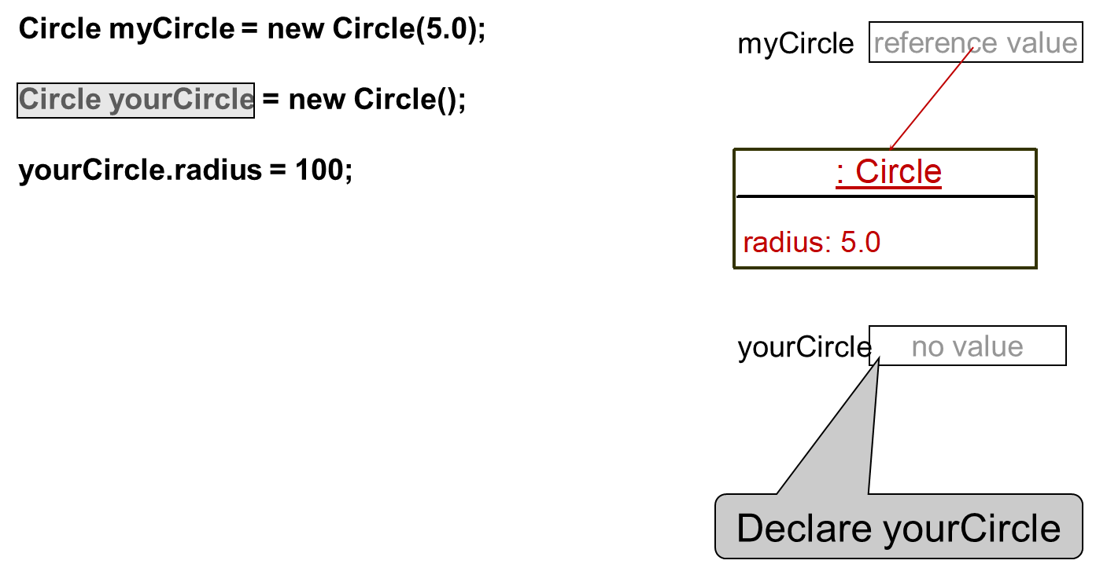
Trace Code (4 of 7)
Notes:
The computer code consists 5 lines. Line 1, indicates Circle my Circle equal to new Circle open parenthesis 5.0 close parenthesis semicolon. Line 2, blank. Line 3, Circle my Circle equal to new Circle open parenthesis close parenthesis semicolon.ine 4, blank. Line 5, your Circle period radius equal to hundred semicolon. A right upward side text box shows 1 Row for my Circle i.e. reference value and it also shows an arrow of red colour. A rightward middle text box shows the 2 rows. Row 1 shows the Create a circle by coding i.e. colon Circle. Row 2 shows the radius colon 5.0. A right downward side text box shows the 1 row for Declare your Circle i.e. no value.

Slide 27
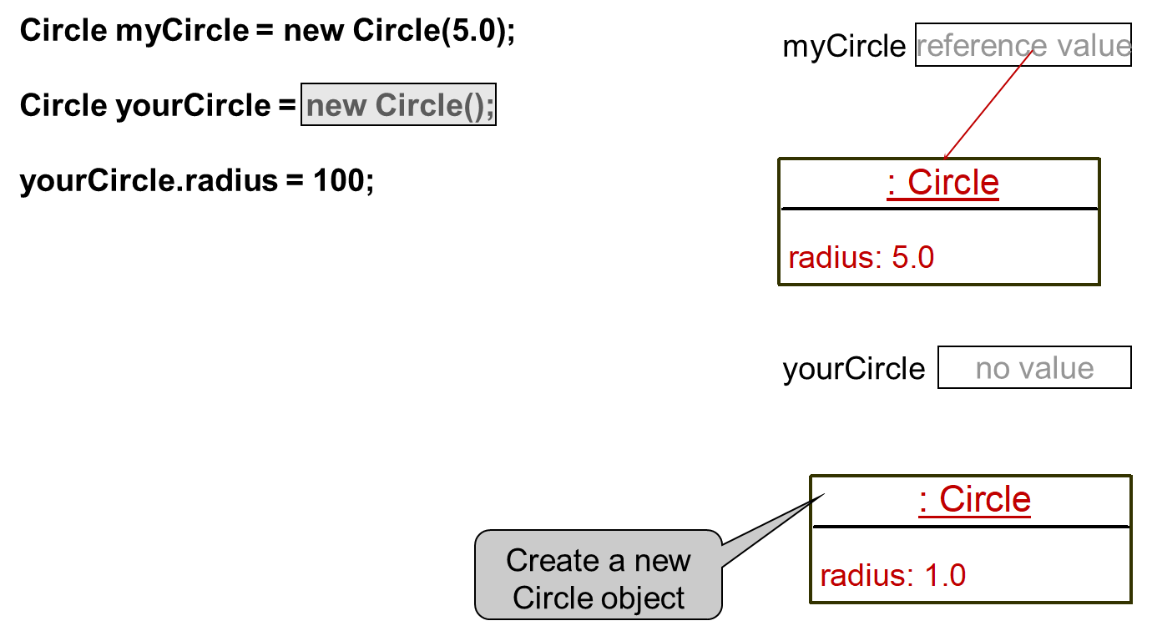
Trace Code (5 of 7)
Notes:
The computer code consists 5 lines. Line 1, indicates Circle my Circle equal to new Circle open parenthesis 5.0 close parenthesis semicolon. Line 2, blank. Line 3, Circle my Circle equal to new Circle open parenthesis close parenthesis semicolon line 4, blank. Line 5, your Circle period radius equal to hundred semicolon. A right upward side text box shows 1 Row for my Circle i.e. reference value and it also shows the red color arrow. A rightward middle text box shows the 2 rows. Row 1 shows the Create a circle by coding i.e. colon Circle. Row 2 shows the radius colon 5.0.A rightward middle side text box shows the 1 row for Declare your Circle i.e. no value. A right downward text box shows 2 rows for Create a new Circle object. Row 1 shows the colon Circle. Row 2 shows the radius colon 1.0.

Slide 28
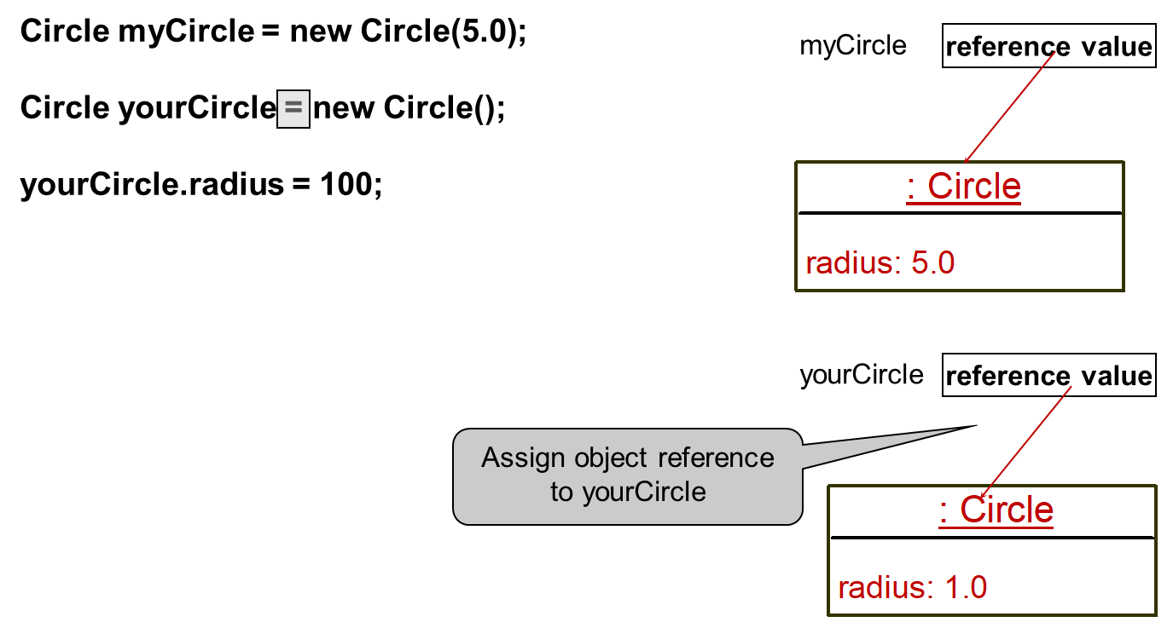
Trace Code (6 of 7)
Notes:
The computer code consists 5 lines. Line 1, indicates Circle my Circle equal to new Circle open parenthesis 5.0 close parenthesis semicolon. Line 2, blank. Line 3, Circle my Circle equal to new Circle open parenthesis close parenthesis semicolon.ine 4, blank. Line 5, your Circle period radius equal to hundred semicolon. A right upward side text box shows 1 Row for my Circle i.e. reference value and it also shows the red color arrow. A rightward middle text box shows the 2 rows. Row 1 shows the Create a circle by coding i.e. colon Circle. Row 2 shows the radius colon 5.0. A rightward middle side text box shows the 1 row i.e. reference value for assign object reference to your circle and it also shows the red colour arrow. A right downward text box shows 2 rows for Create a new Circle object. Row 1 shows the colon Circle. Row 2 shows the radius colon 1.0.

Slide 29
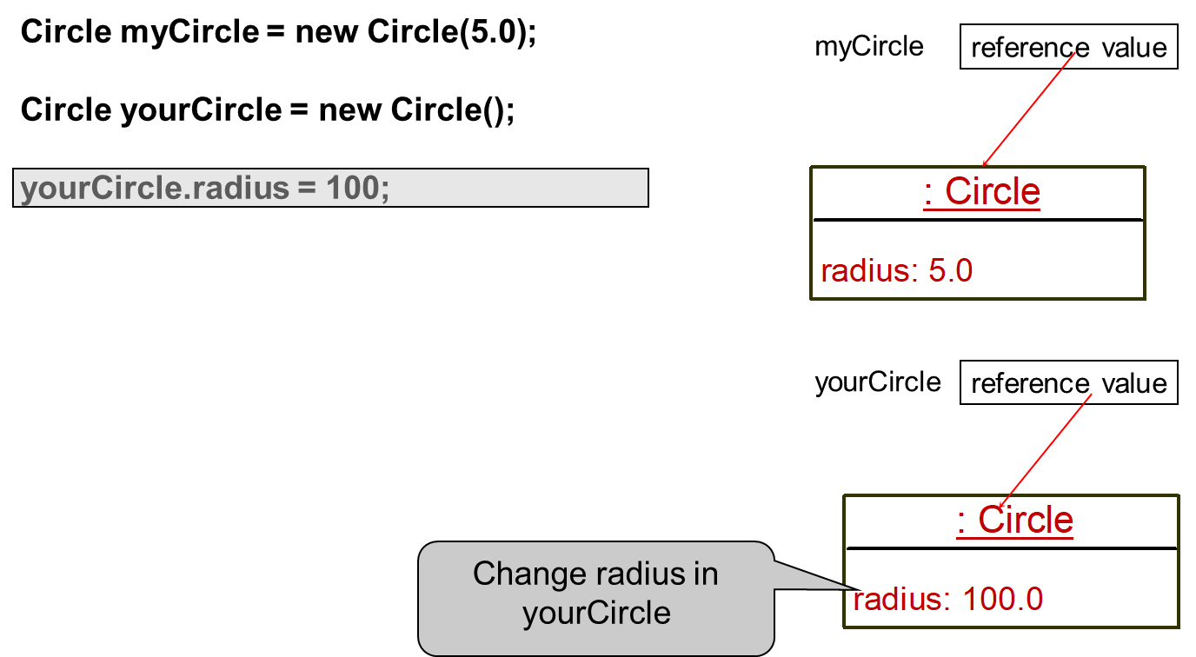
Trace Code (7 of 7)
Notes:
The computer code consists 5 lines. Line 1, indicates Circle my Circle equal to new Circle open parenthesis 5.0 close parenthesis semicolon. Line 2, blank. Line 3, Circle my Circle equal to new Circle open parenthesis close parenthesis semicolon.ine 4, blank. Line 5, your Circle period radius equal to hundred semicolon. A right upward side text box shows 1 Row for my Circle i.e. reference value and it also shows the red colour arrow. A rightward middle text box shows the 2 rows. Row 1 shows the Create a circle by coding i.e. colon Circle. Row 2 shows the radius colon 5.0.A rightward middle side text box shows the 1 row for Declare your Circle i.e. reference value and it also shows the red color arrow. A right downward text box shows 2 rows for Create a new Circle object. Row 1 shows the colon Circle. Row 2 shows the Change radius in your circle by coding i.e. radius colon 100.0.

